Slide 1
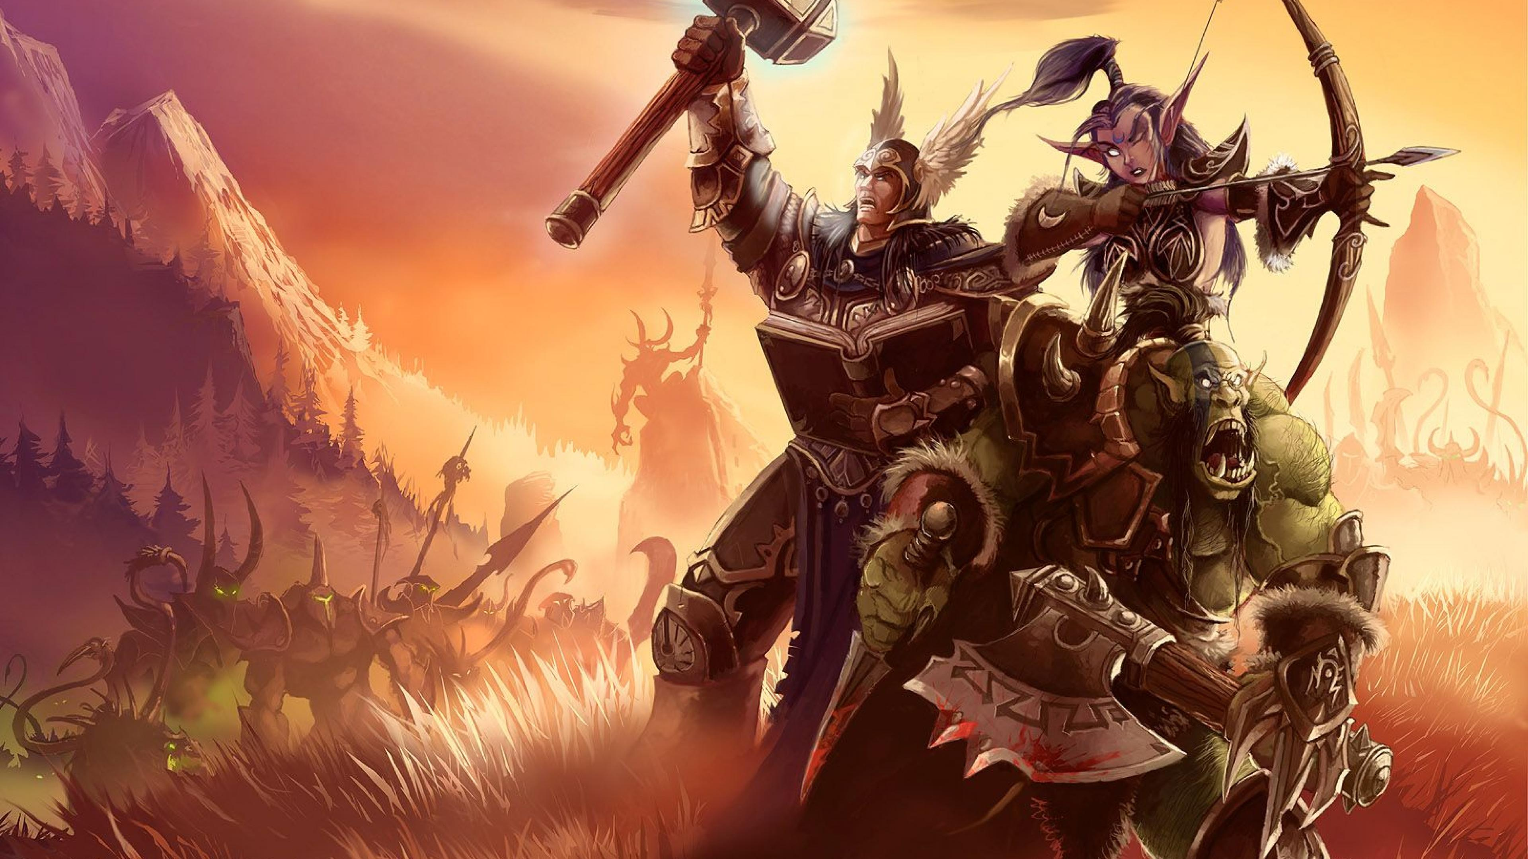
Reverse-Engineering
Noel Danz & Raoul Baron – WS18/19
Extracting Game Assets from Warcraft 1 (MacOS)

Slide 2
Overview
What we had as a starting point
What we have done so far
Which tools we were/are missing
What we want to from here on

Slide 3
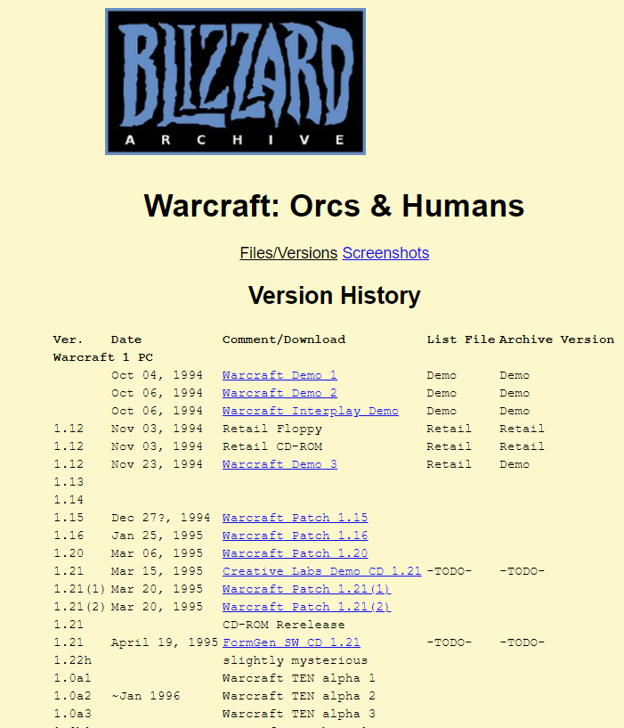
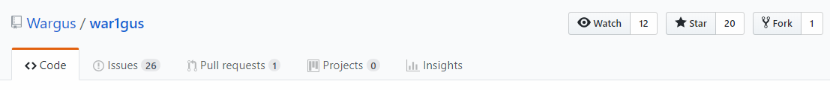
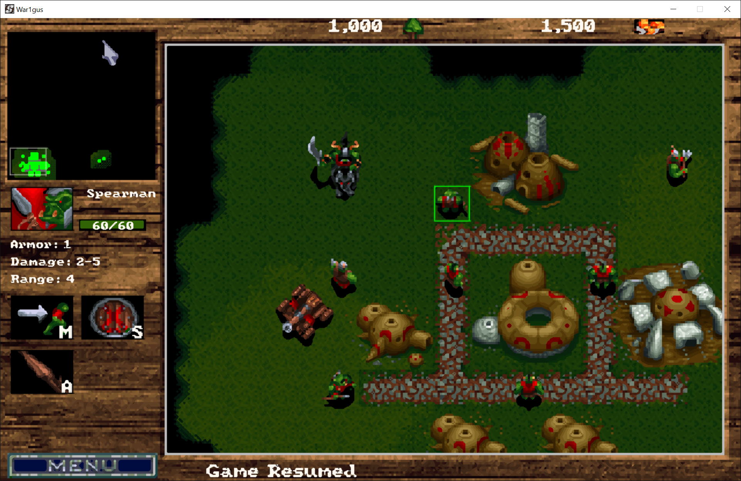
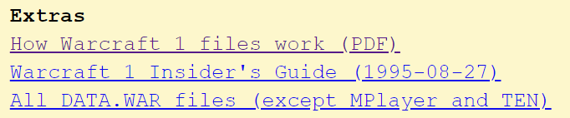
What we had as a starting point
BIN-FILE

Slide 4
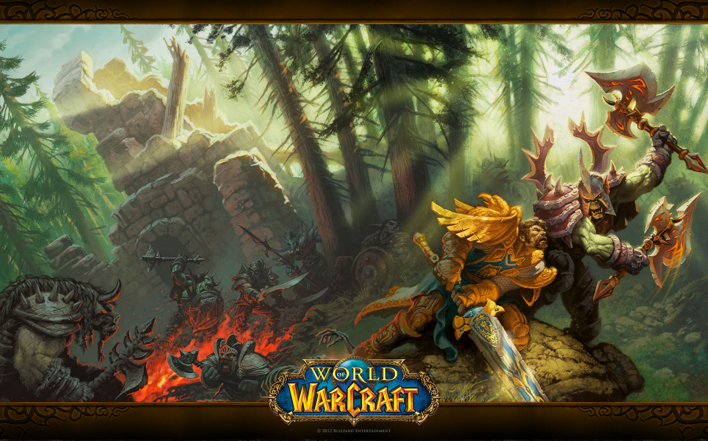
What we have done so far
(tried to) understand the WarData format
rewrite some extraction tools in Python
collected problems we‘ve encountered while working
extracted text & audio
developed some ideas for helpful tools

Slide 5
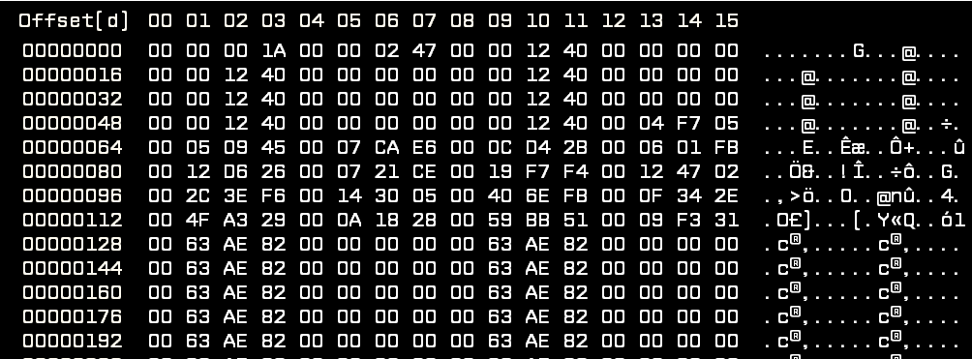
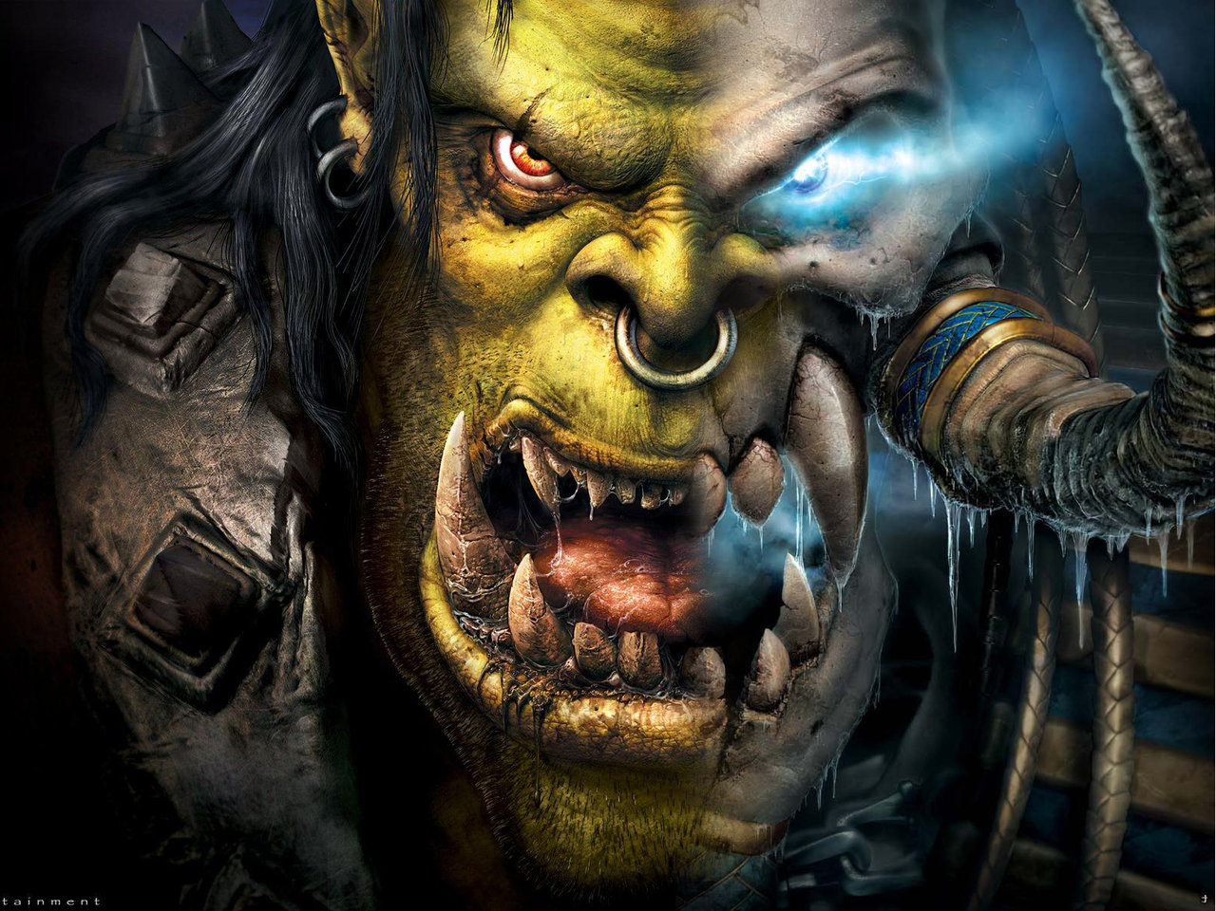
What we‘ve done so far – the format
HEADER (MacOS)
Filetable Entry

Slide 6
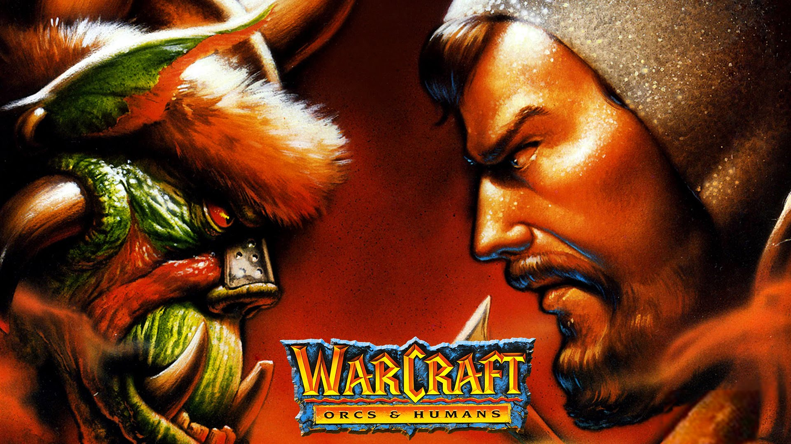
What we‘ve done so far – the format
Filetable Entry
Placeholder: 00 00 00 00 || FF FF FF FF
Retail-Placeholder: 00 00 00 00 (increment with each occurence)
20 0A 00 00
→ 3rd highest bit decides if compressed
→ & 0x1FFFFFFF gives (uncompressed) filesize
→ offsets[n+1]-offsets[n]-4 to get blobsize

Slide 7
What we‘ve done so far – extraction
we‘ve collected some heuristics for deciding filetypes
classic: magic numbers, headers
„provable“ statements
File-Entropy
develop a scoring method to compare probabilities for different formats
use the „provable“ statements as indicators
make automated decisions based upon the indicators

Slide 8
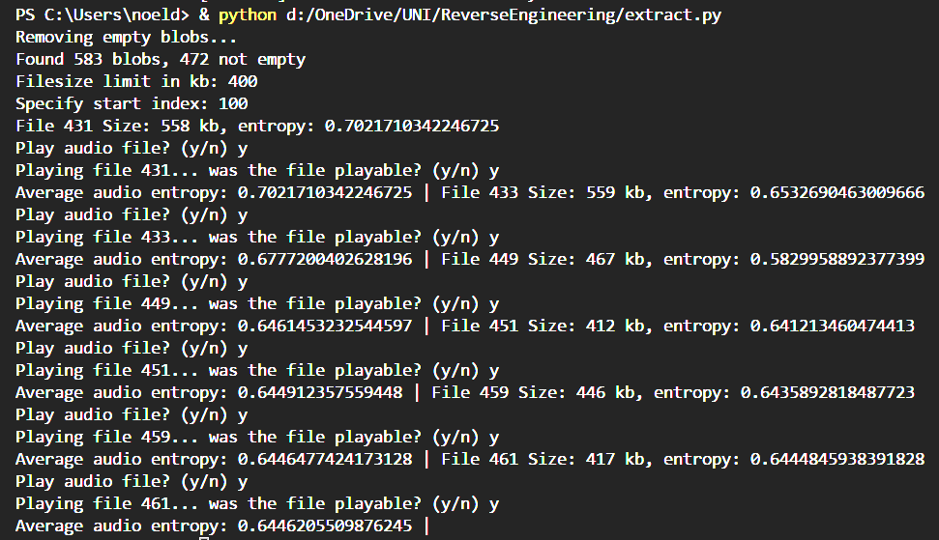

What we‘ve done so far – Demo Time!

Slide 9
What we‘ve done so far – ideas for tools
a GUI for analyzing the probabilities that a given blob of data contains a certain filetype
marking that part of the file & extracting it
a way to describe the probability that a file is of a certain type

Slide 10
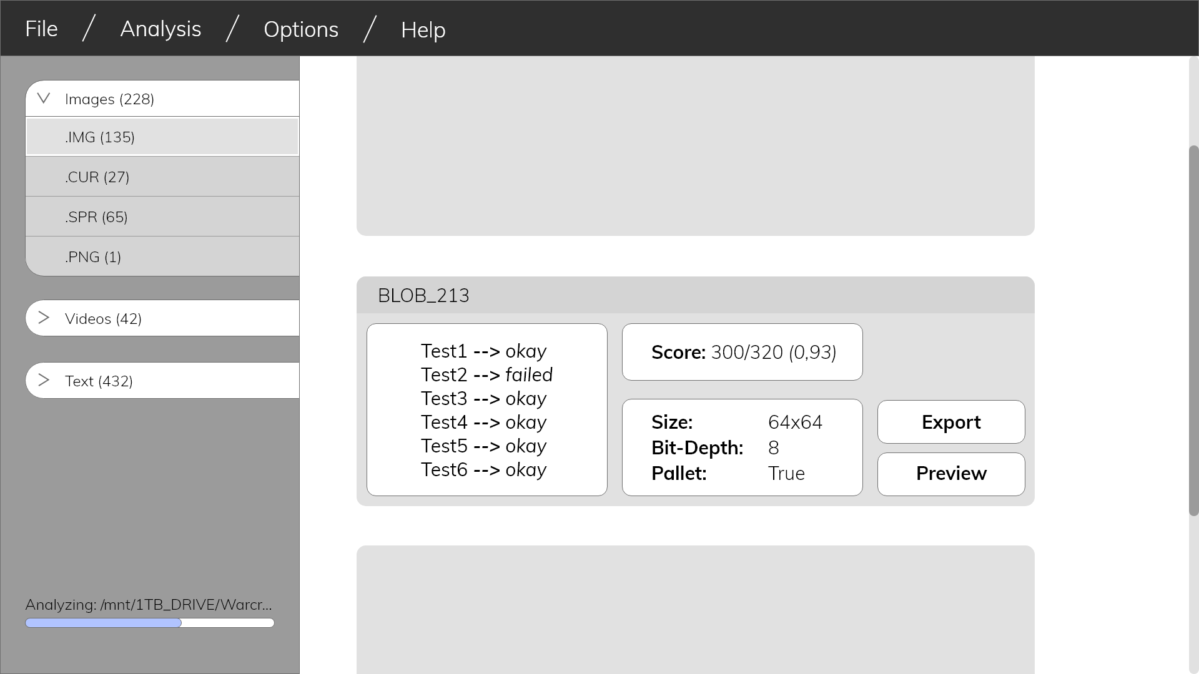
What we‘ve done so far – ideas for tools

Slide 11
What we want to do from here on
develop the presented tools (for better ease-of-use)
evaluate developed indicators (e.g. For JPEGs)
extract all available assets from the Binary (as it is the original task)
Thanks!

